Slide 1
R Champions
Omar Ahmouda, Leona Bell, Helen Chu, Hoai Do, Delaney Smith
BANA 4080 - Homework 4
Australian Weather Data & Abalone Data

Slide 2
Goal
In this assignment, we will use both discriminant analysis and k-nearest neighbors to predict rain.
We will also use k-nearest neighbors to predict the age of abalone.

Slide 3
Australian Weather Data

Slide 4
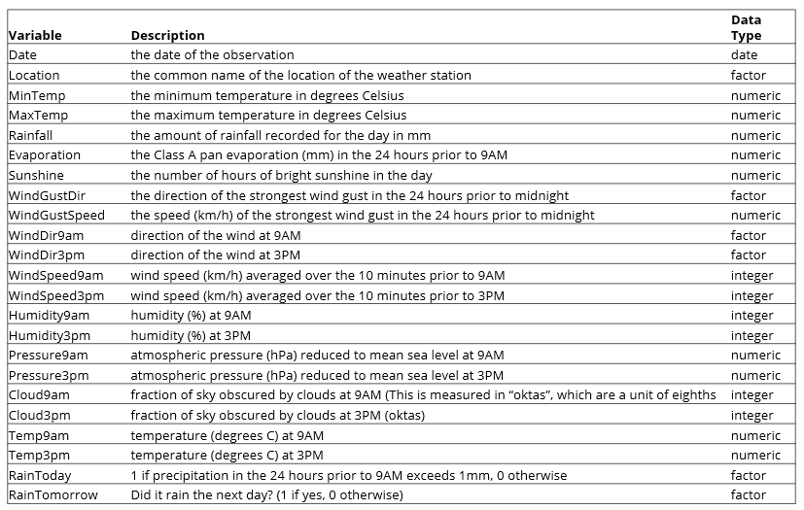
EDA: Data Definitions

Slide 5
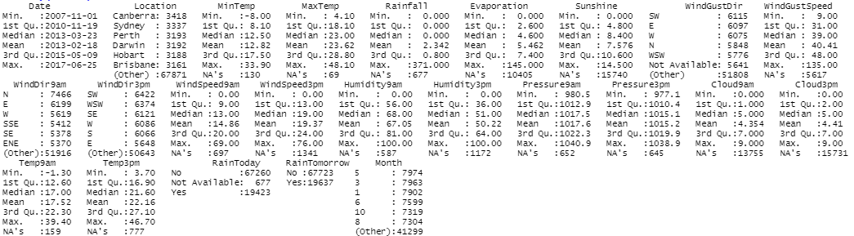
EDA: Summary of the Data
87360 Total Observations. 24 variables (16 numeric, 8 categorical)

Slide 6
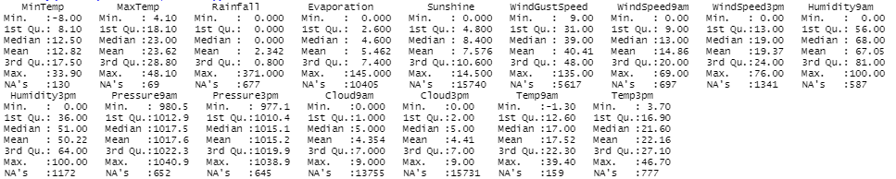
EDA: Summary of the Data
16 numeric variables
Prominent Missing Data within Sunshine, Cloud3pm, Cloud9am, Evaporation, WindGustSpeed
Positively Skewed Variables: Rainfall, Evaporation, WindGustSpeed, WindSpeed9am
Negatively Skewed Variables: Sunshine
Some outliers, but none so extreme that it could be considered bad data and be removed

Slide 7
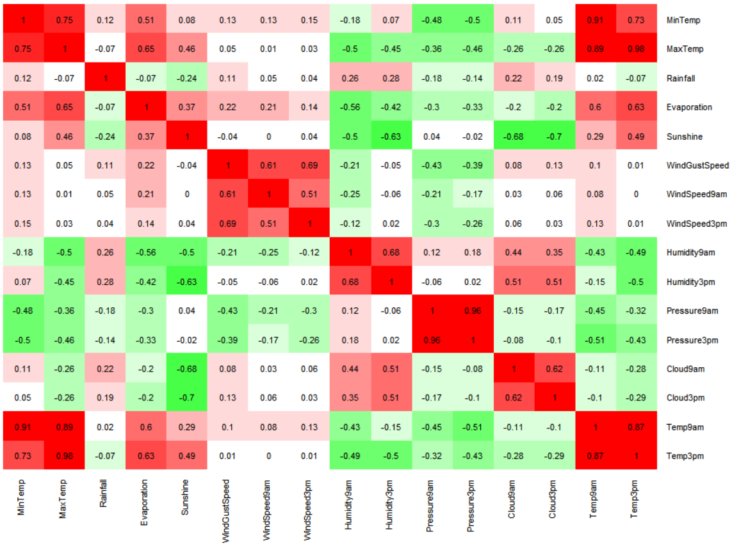
EDA: Correlation Matrix
Strong Positive Correlations:
MinTemp with MaxTemp, Temp9am, and Temp3pm
MaxTemp with Temp9am and Temp3pm
Pressure9am with Pressure3pm
Temp9am with Temp3pm
Strong Negative Correlations:
Sunshine and Cloud3pm.
Multicollinearity:
MaxTemp and Temp3pm
Pressure9am and Pressure3pm

Slide 8
Pre-Processing Data
In order to reduce multicollinearity, the variables Temp3pm and Pressure3pm were removed from the data set. Now there are no relationships with a correlation stronger than 0.75.
As per the directions, Date and Location were also removed from the dataset.
In addition, blank records were deleted from the data set.
We dropped any unused levels for RainToday.

Slide 9
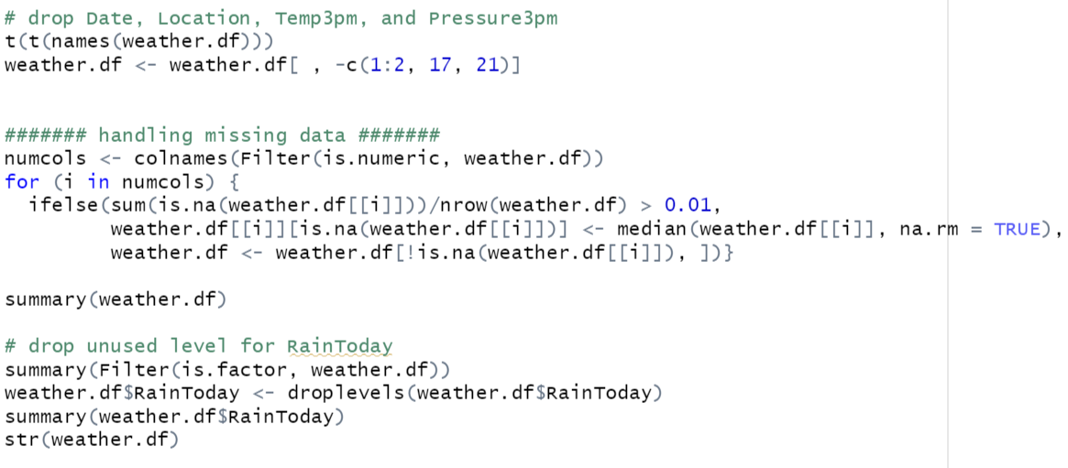
Pre-Processing Data

Slide 10
Australian Weather Data
Discriminant Analysis

Slide 11
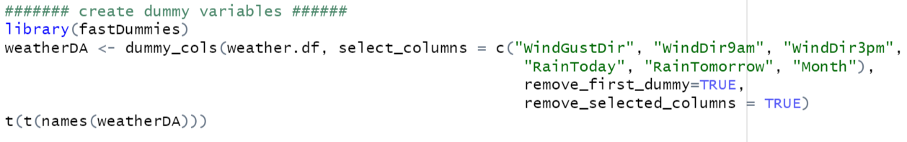
Creating Dummy Variables
Because we are performing Discriminant Analysis for this data, we removed dummy variables to avoid multicollinearity.

Slide 12
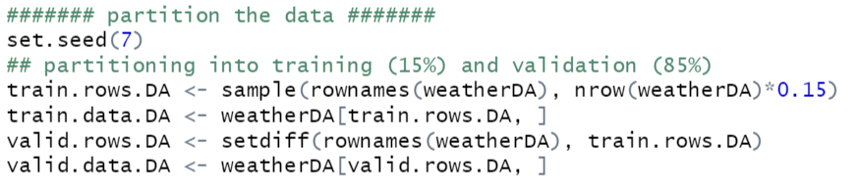
Partitioning the Data
After pre-processing, we partitioned the data training and validation datasets. The training and validation sets were created from the model by training the model on 15% of the data. The validation set will evaluate the model with the remaining 85% of the data.

Slide 13
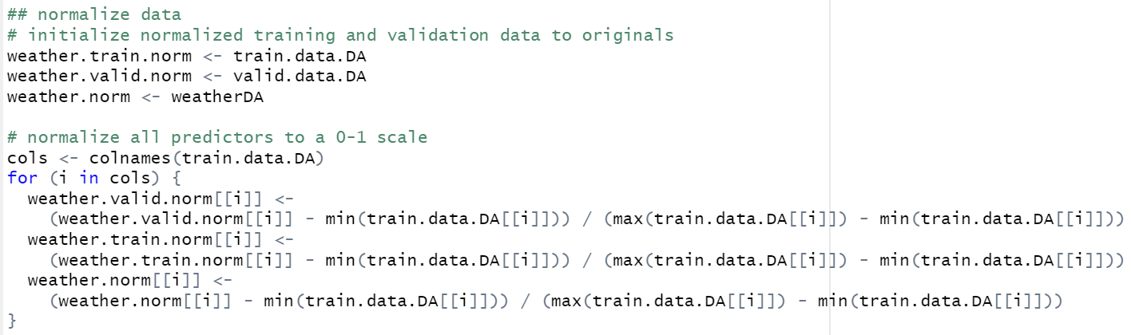
Normalizing
Next we normalized all predictors to a 0-1 scale for easier calculations.

Slide 14
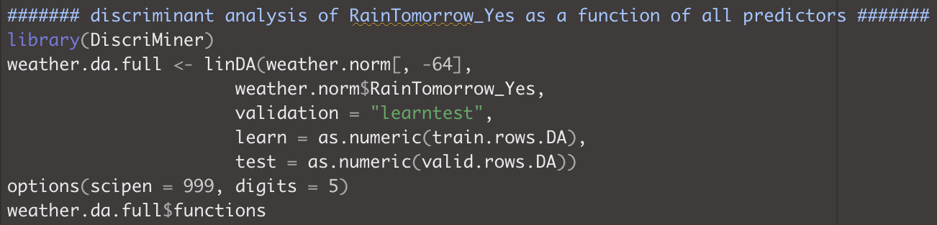
Discriminant Analysis

Slide 15
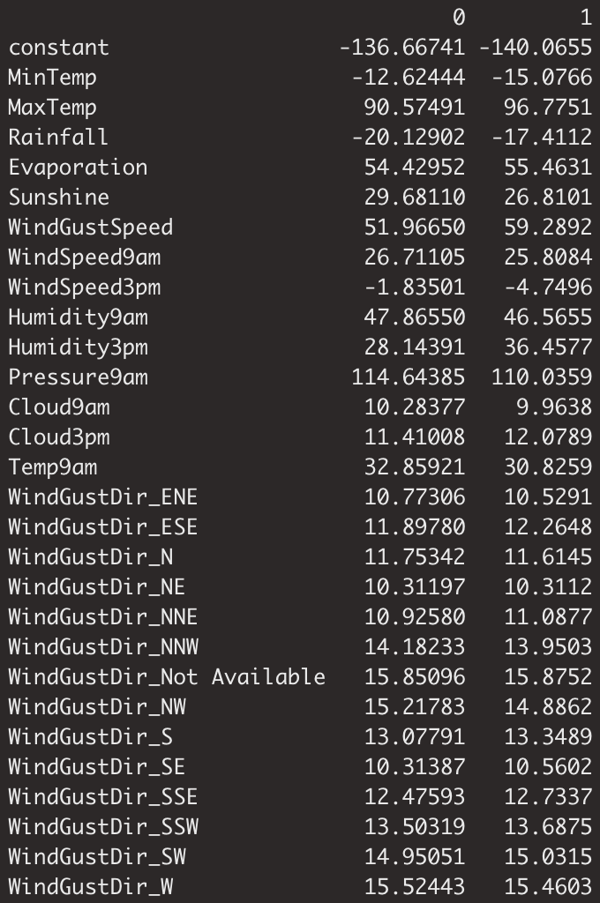
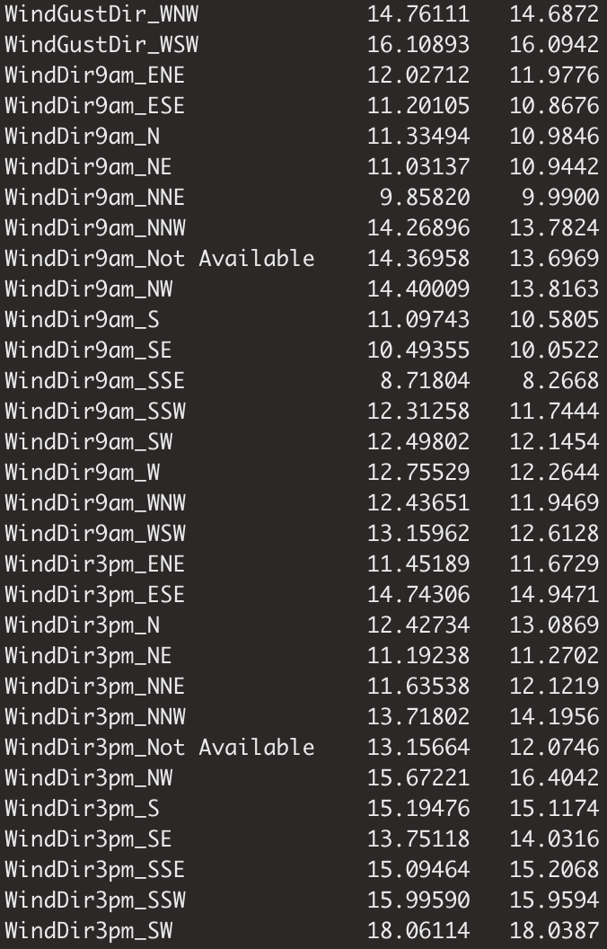
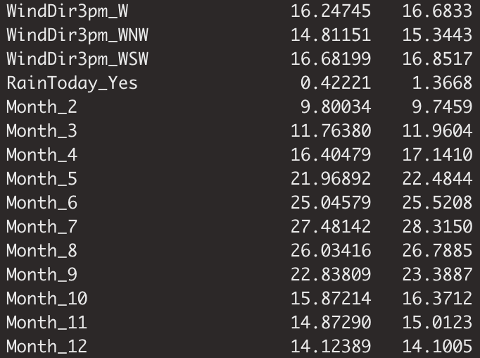
Discriminant Analysis Coefficients

Slide 16
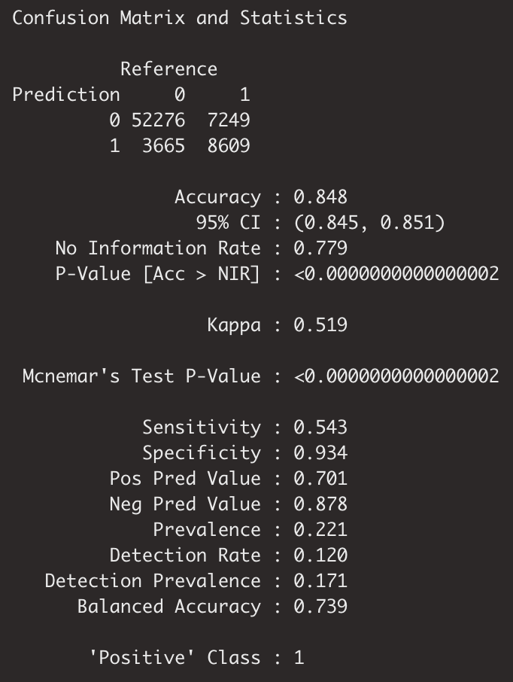
Confusion Matrix
Based on the confusion matrix generated from Discriminant Analysis, the model has roughly 85% accuracy.
Correctly classifies 54% of rainy tomorrows.
Misclassification Rate: 15%
_______________________________________________
Misclassified RainTomorrow (1): 46%
7249 / 7249 + 8609
Misclassified RainTomorrow (0): 7%
3665 / 3665 + 52276
Essentially, rain tomorrow is more likely to be misclassified/predicted as no rain tomorrow.

Slide 17
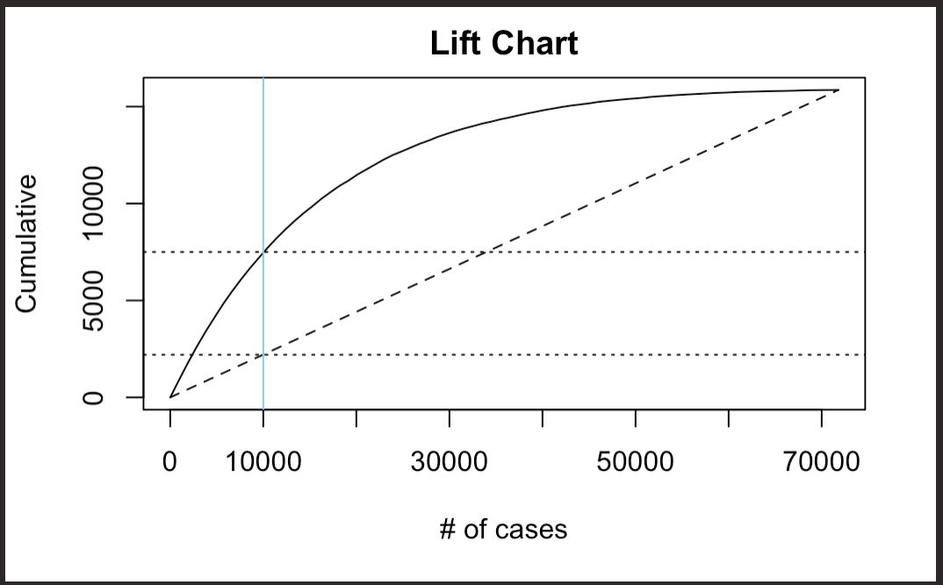
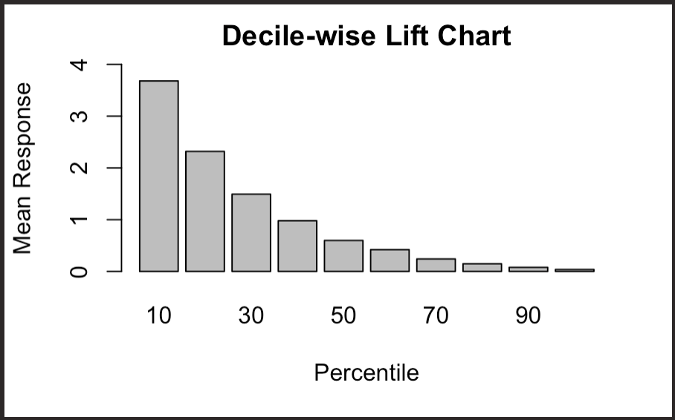
Lift & Decile Chart
Acting upon 10,000 most-likely-to-rain days would allow you to capture about 7,500 days that rain tomorrow and only about 2,200 days if you randomly selected 10,000.
Acting upon the top 10% most-likely-to-rain days would allow you to capture roughly 3.7 times as many days that rain tomorrow than randomly choosing 10%.

Slide 18
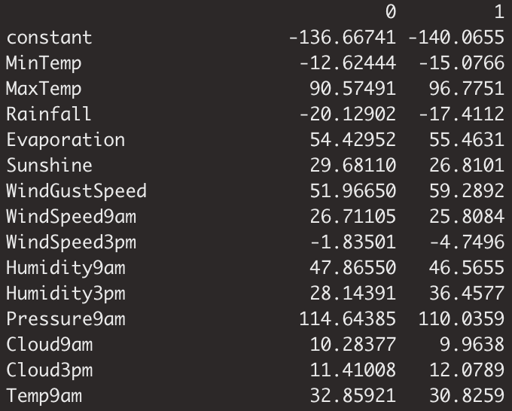
Probability Of Raining The Next Day
These are the coefficients generated from discriminant analysis that we will use to determine whether it will rain the next day.
________________________________
0 - No rain
1- Rain

Slide 19
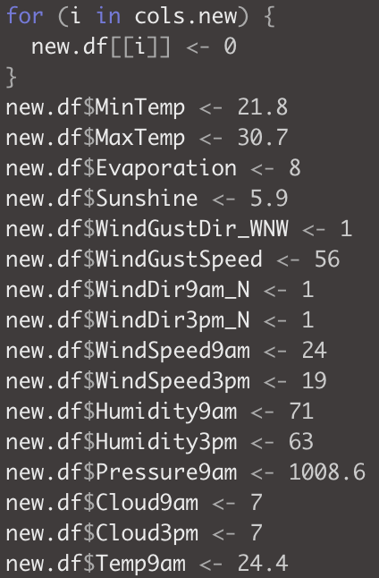
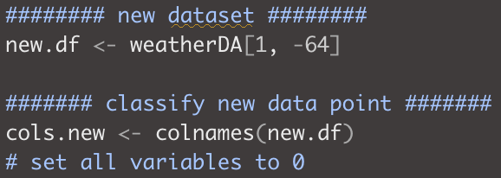
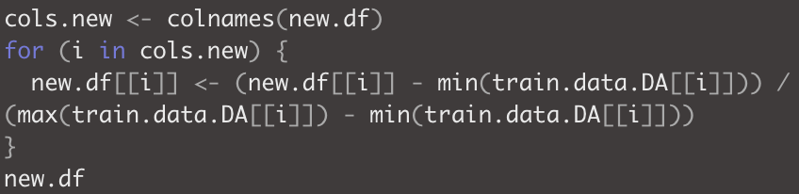
Predictor Values For a Specific Point
Our conditions are as follows: Date = 1/22/2022; MinTemp = 21.8; MaxTemp = 30.7; Rainfall = 0; Evaporation = 8; Sunshine = 5.9; WindGustDir = WNW; WindGustSpeed = 56; WindDir9am = N; WindDir3pm = N; WindSpeed9am = 24; WindSpeed3pm = 19; Humidity9am = 71; Humidity3pm = 63; Pressure9am = 1008.6; Pressure3pm = 1006.2; Cloud9am = 7; Cloud3pm = 7; Temp9am = 24.4; Temp3pm = 27.3; RainToday = No
(We created a new dataframe without the outcome variable in order to standardize these values to use them with classification functions.)

Slide 20
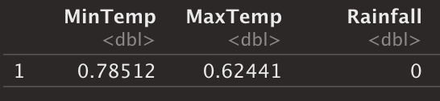
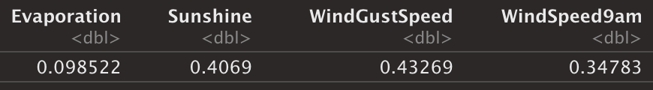
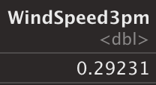
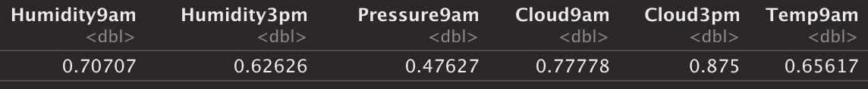
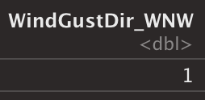
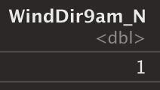
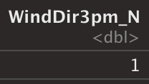
Classification & Probability
The resulting new data-frame consists of one observation and 74 variables. However, only the following variables are what we need to look at (16 nonzero values, 1 zero value).

Slide 21
Classification
constant -136.66741 -140.0655
MinTemp -12.62444 -15.0766
MaxTemp 90.57491 96.7751
Rainfall -20.12902 -17.4112
Evaporation 54.42952 55.4631
Sunshine 29.68110 26.8101
WindGustSpeed 51.96650 59.2892
WindSpeed9am 26.71105 25.8084
WindSpeed3pm -1.83501 -4.7496
Humidity9am 47.86550 46.5655
Humidity3pm 28.14391 36.4577
Pressure9am 114.64385 110.0359
Cloud9am 10.28377 9.9638
Cloud3pm 11.41008 12.0789
Temp9am 32.85921 30.8259
WindGustDir_WNW 14.76111 14.6872
WindDir9am_N 11.33494 10.9846
WindDir3pm_N 12.42734 13.0869
Classification Scores
No Rain Tomorrow (0) -
-136.66741 + -12.62444(0.78512) + 90.57491(0.62441) + -20.12902(0) + 54.42952(0.098522) + 29.68110(0.4069) + 51.96650(0.43269) + 26.71105(0.34783) + -1.83501(0.29231) + 47.86550(0.70707) + 28.14391(0.62626) + 114.64385(0.47627) + 10.28377(0.77778) + 11.41008(0.875) + 32.85921(0.65617) + 14.76111(1) + 11.33494(1) + 12.42734(1) = 142.79445
____________________________________________________________________
Rain Tomorrow (1) -
-140.0655 + -15.0766(0.78512) + 96.7751(0.62441) + -17.4112(0) + 55.4631(0.098522) + 26.8101(0.4069) + 59.2892(0.43269) + 25.8084(0.34783) + -4.7496(0.29231) + 46.5655(0.70707) + 36.4577(0.62626) + 110.0359(0.47627) + 9.9638(0.77778) + 12.0789(0.875) + 30.8259(0.65617) + 14.6872(1) + 10.9846(1) + 13.0869(1) = 143.60897
143.60897 > 142.79445
____________________________________________________________________
Based on classification scores, this model will predict that it will rain tomorrow.

Slide 22
Probability
Classification Scores:
No Rain Tomorrow- 142.79445
Rain Tomorrow - 143.60897
Probability it will rain the next day:
e^143.60897 / (e^143.60897 + e^142.79445) = 0.69307
In other words, there is a 69% chance of rain the next day!

Slide 23
Australian Weather Data
k-Nearest Neighbors for Classification

Slide 24
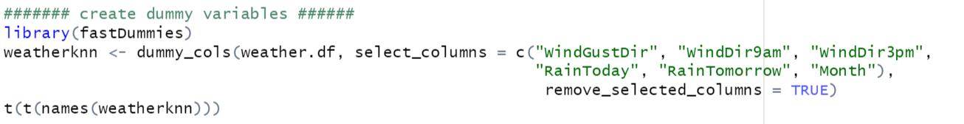
Creating Dummy Variables
Because we are also performing k-nearest neighbors for this data, we kept all of the dummy variables.

Slide 25
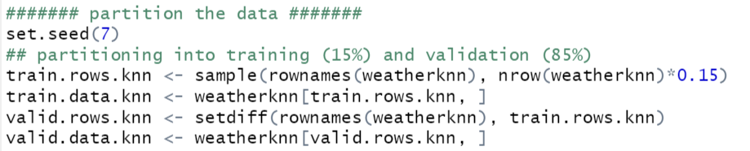
Partitioning the Data
After pre-processing, we partitioned the data training and validation datasets. The training and validation sets were created from the model by training the model on 15% of the data. The validation set will evaluate the model with the remaining 85% of the data.

Slide 26
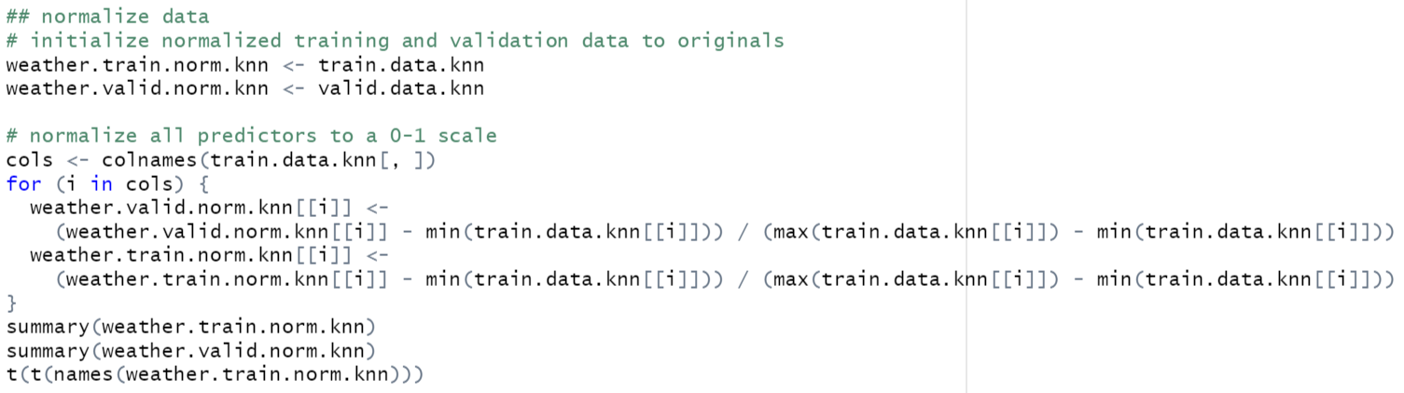
Normalizing
Next we normalized all predictors to a 0-1 scale for easier calculations.

Slide 27
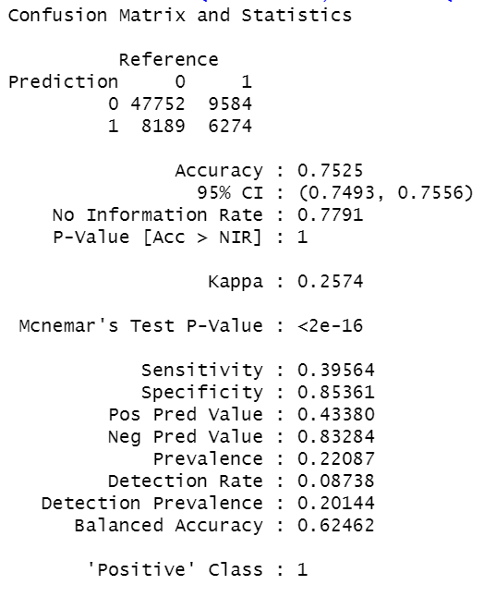
k-NN Classification With All Predictors Using k=1
According to the confusion matrix, this algorithm does not do a good job of identifying rainy days. The accuracy is only 75.25% and the precision and prevalence values are too low. This indicates the algorithm can’t be relied on to identify rainy days.

Slide 28
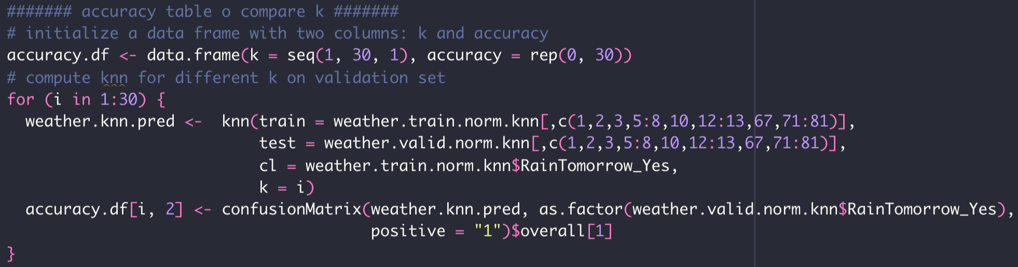
Accuracy Table
Use the Forward Selection based predictors to build k-NN model, since personal computer could stop when running a full-model on this large dataset with higher Ks
To determine the optimal k, we evaluate the accuracy on the validation data at every reasonable values of k.
It is often only necessary to look at the first 20-30 ks, as evaluating a large number of k is computationally expensive.

Slide 29
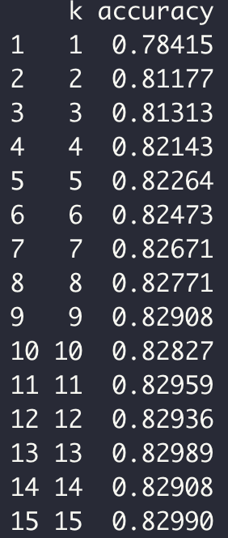
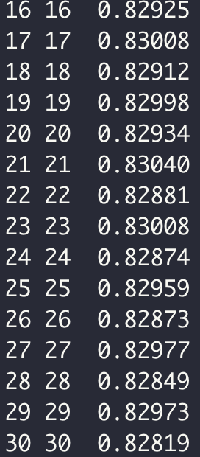
Accuracy Table
The highest accuracy is generated with the value of k equals 21
The k=1 generate the poorest performance
From k2 to k17, the accuracy performance generally increase, but slightly fluctuates from k18-k20, before reaches its top performance at k21.
There are several Ks have the sem accuracy: e.g, k9 - k14, k11- k25, k17 - k23

Slide 30
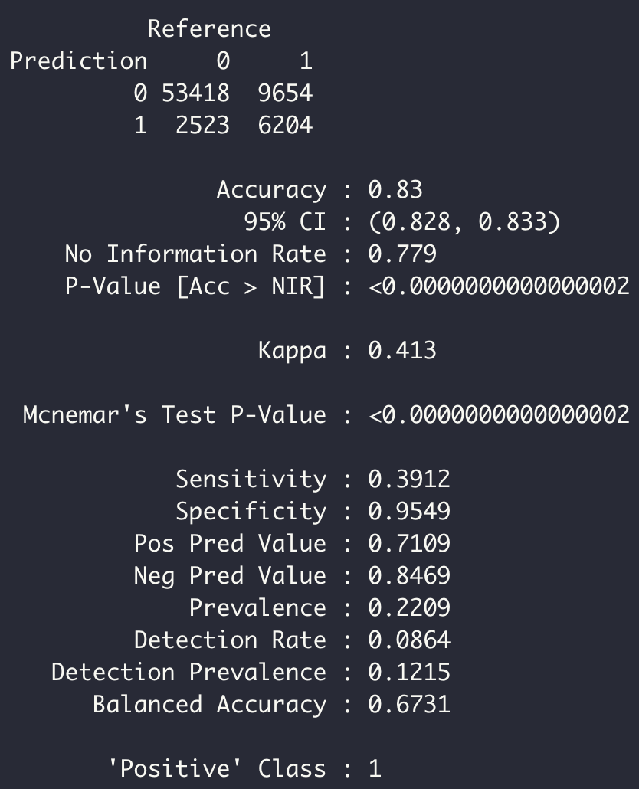
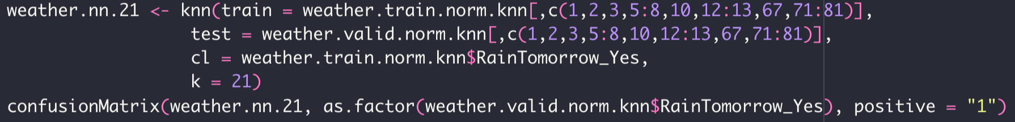
Confusion Matrix
Using 21 as optimal k
As the Sensitivity results at 0.3912, it’s not a good algorithm to predict a rainy day.
Probably, we would love to bring a spare umbrella instead of not having it when it starts raining.
Since the trade-off of having model incorrectly classifies the “non-rainy day” as “rainy day” is more preferable.

Slide 31
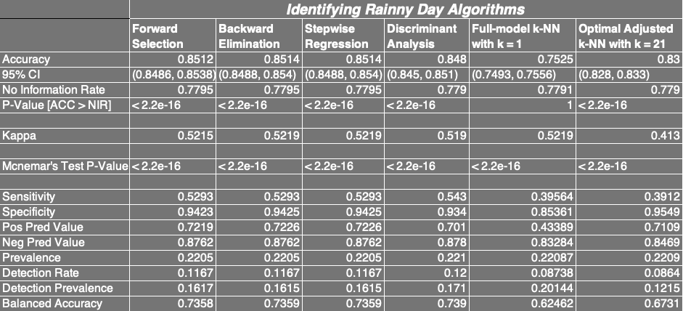
Summary Table
The k-NN algorithm poorly performs in identifying the rainy day. Roughly 25% worse.
And the Discriminant Analysis results as the best algorithm in identifying rainy day correctly, accompanies a sensitivity of 0.543. Just slightly higher than the Variable Selection Methods

Slide 32
Abalone Data
k-Nearest Neighbors for Prediction

Slide 33
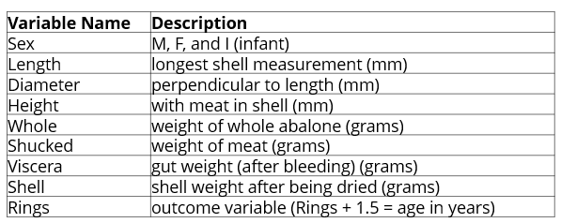
EDA: Data Definitions

Slide 34
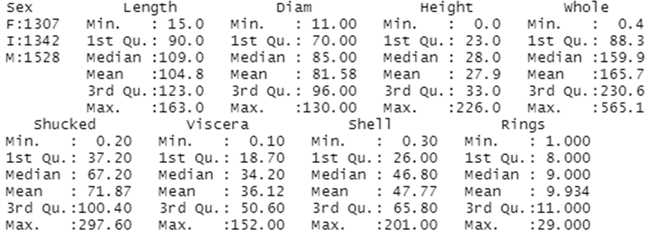
EDA: Summary of the Data
No missing data.
Length and Diam appear to be negatively skewed.
Whole, Shucked, Viscera, Shell, and Rings appear to be positively skewed.
Height seems to have one extreme outlier.

Slide 35
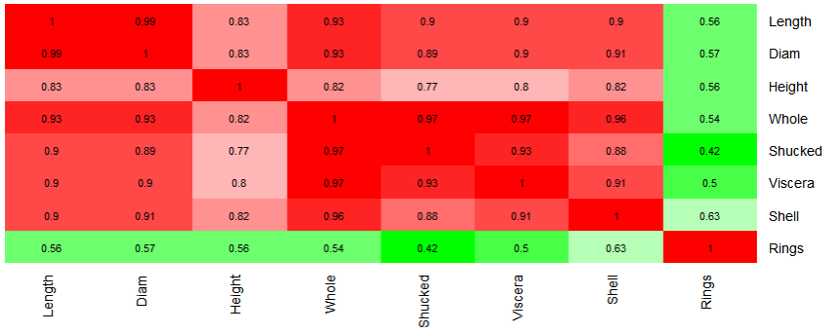
EDA: Correlation Matrix
Length and Diam have a 0.99 correlation - one of these should be removed.
Whole should be removed because of its strong correlations of 0.95 or greater to Shucked, Viscera, and Shell.

Slide 36
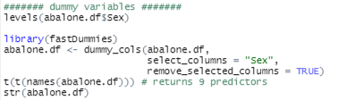
Pre-Processing Data
In order to reduce multicollinearity, the variables Whole and Length were removed from the data set. Now there are no relationships with a correlation stronger than 0.75.
We also removed extreme outliers for Height from the dataset.
Lastly, we created dummy variables for Sex without removing a predictor.

Slide 37

Partitioning the Data
After pre-processing, we partitioned the data training and validation datasets. The training and validation sets were created from the model by training the model on 70% of the data. The validation set will evaluate the model with the remaining 30% of the data.

Slide 38
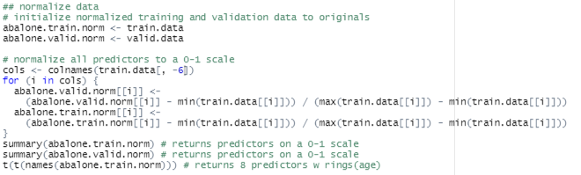
Normalizing the Data
Next we normalized all predictors to a 0-1 scale for easier calculations.

Slide 39
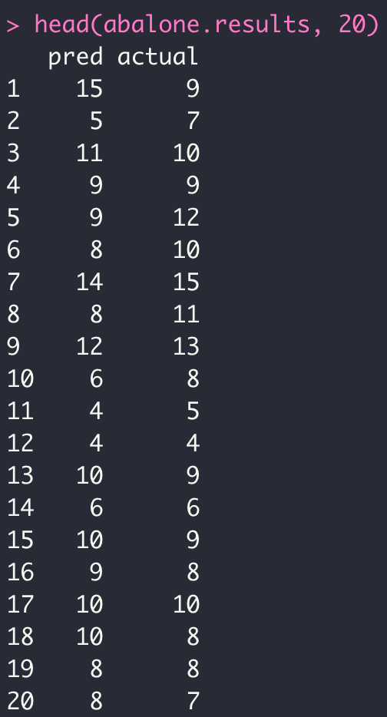
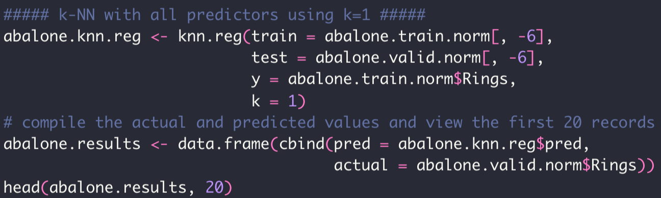
k-NN with all predictors using k=1
We will now use k-NN to predict the quantitative outcome Abalone Rings.
Deploy `knn.reg` function from FNN package at k=1
Compile the actual and predicted values and take a look at the first 20 records

Slide 40
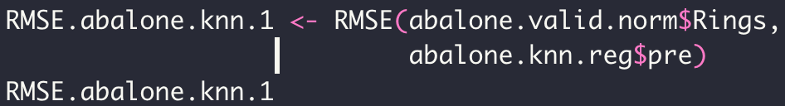

RMSE Check on k-NN with k = 1
Using the `RMSE` function to evaluate the predictive model performance
With k=1, the RMSE is 2.95 indicating a fact that this is just a quiet good model predicting the ages of abalone.

Slide 41
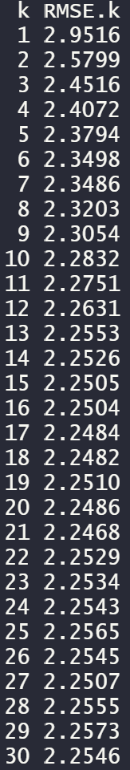
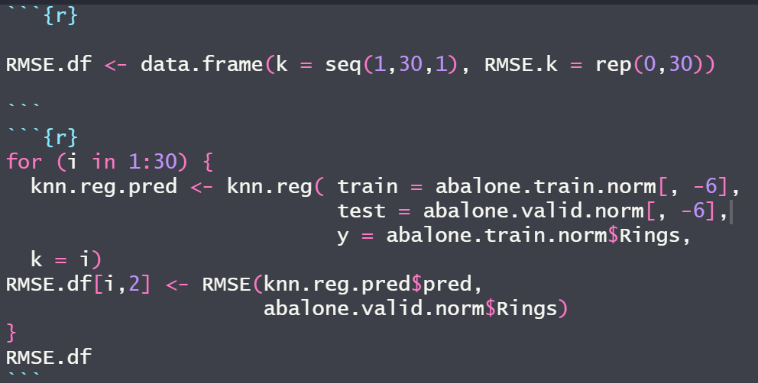
Creating an RMSE table to find Optimal K value
Now, we will create a table to test k values from 1-30 to determine which k value has the lowest RMSE value.
From the RMSE table, we can see that k=21 is the optimal k as it has the lowest RMSE of all k values tested.

Slide 42
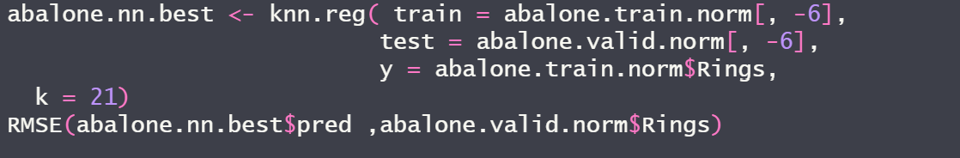
RMSE from Using Best K Value (K=21)
To confirm our optimal k value from our RMSE table we performed KNN with k=21 and got the same lowest RMSE of 2.2468.

Slide 43
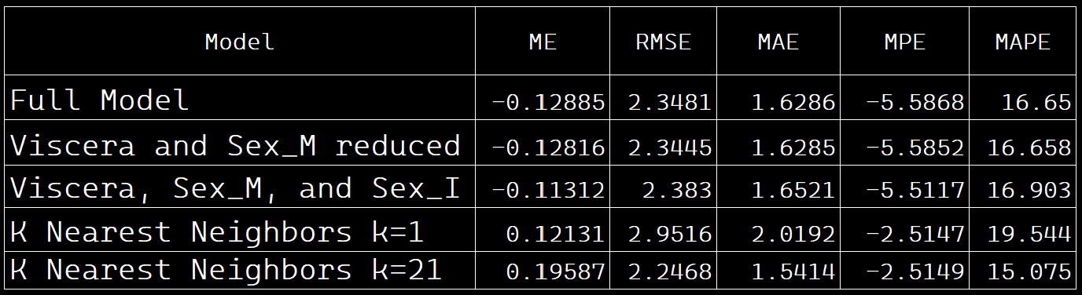
Choosing the Best Model
KNN with k=21 does a great job at predicting abalone age.
Out of all of the models, we would pick KNN with optimal k(k=21) as the best model for predicting abalone age, as it has the lowest RMSE, MAE, and MAPE.

